Slide 1

Database System Analysis
Fact-finding Techniques
Lecture 3 - Chapter 10-11
Spring 2026
© Pearson Education Limited 1995, 2015

Slide 2
Objectives
When fact-finding techniques are used in the database application lifecycle.
The types of facts collected in each stage of the database application lifecycle.
The types of documentation produced in each stage of the database application lifecycle.
© Pearson Education Limited 1995, 2005

Slide 3
Objectives
The most commonly used fact-finding techniques.
How to use each fact-finding technique and the advantages and disadvantages of each.
About a property rental company called DreamHome.
How to apply fact-finding techniques to the early stages of the database application lifecycle.
© Pearson Education Limited 1995, 2005

Slide 4
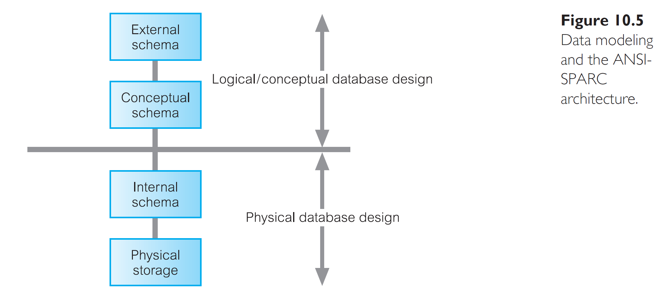


Slide 5
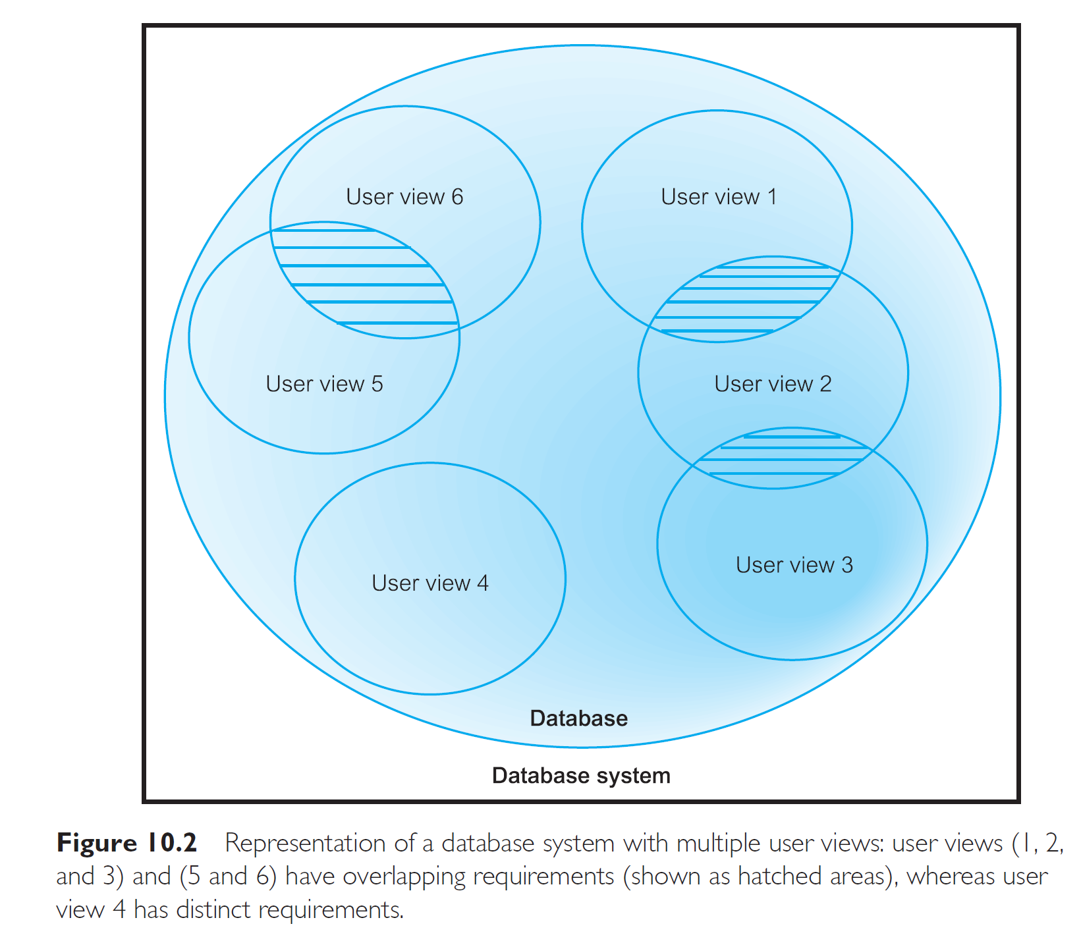

Slide 6
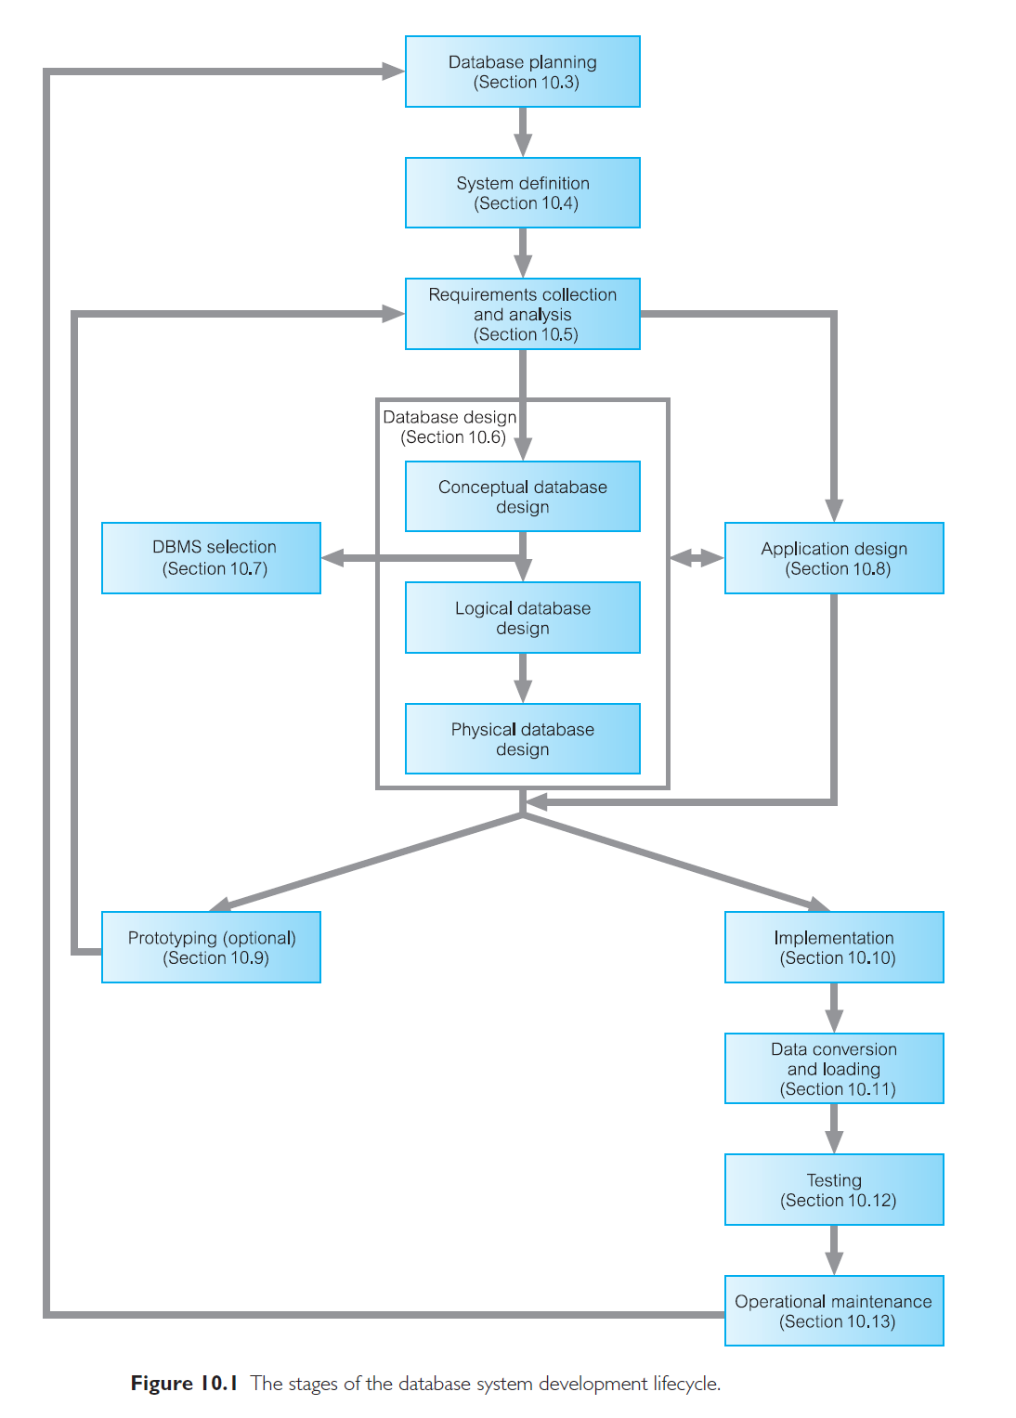

Slide 7
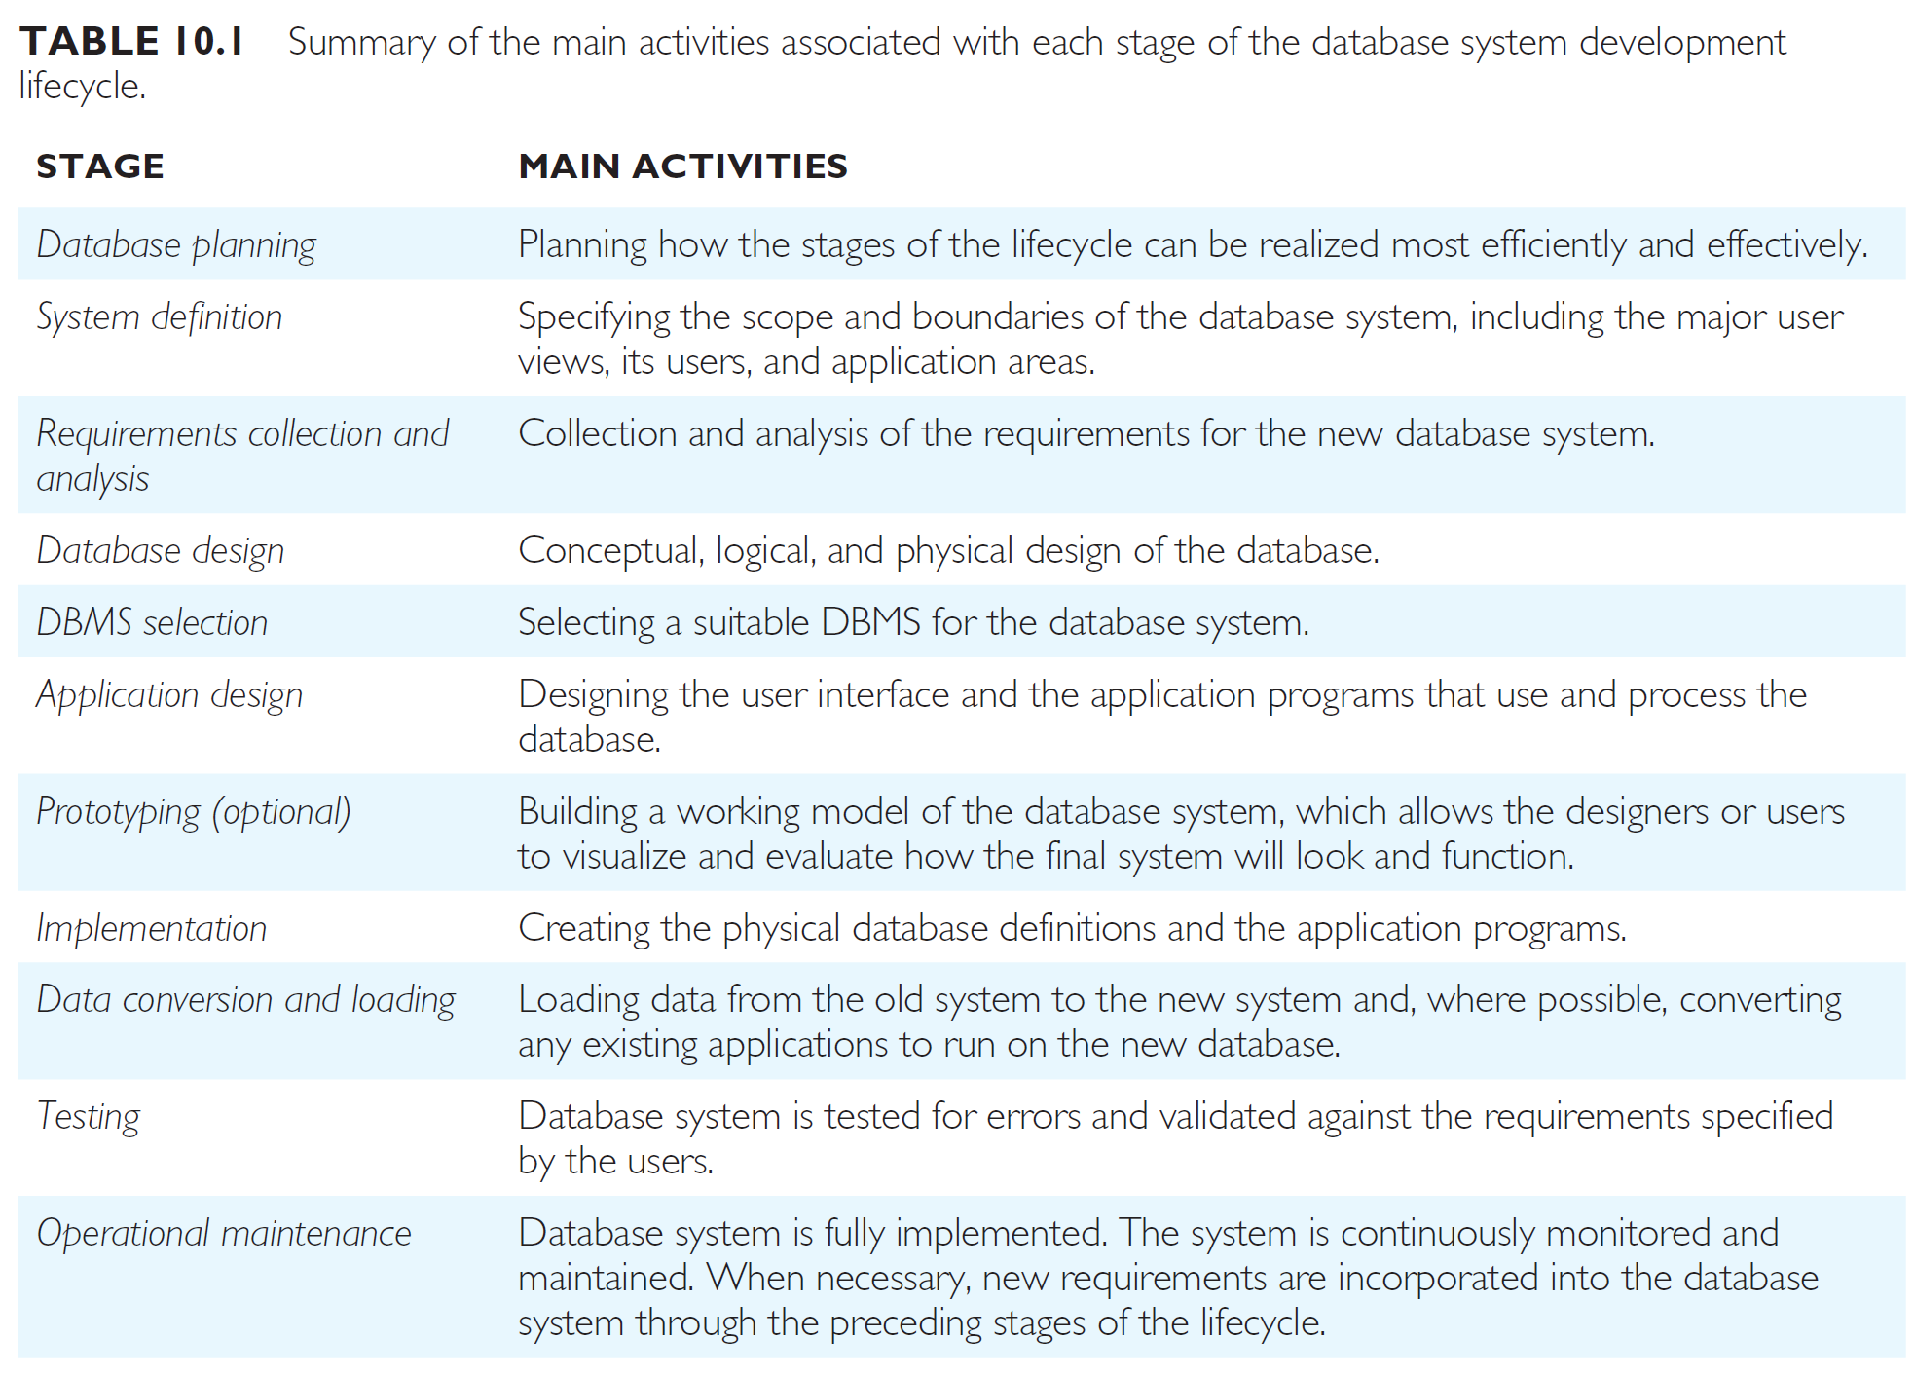

Slide 8
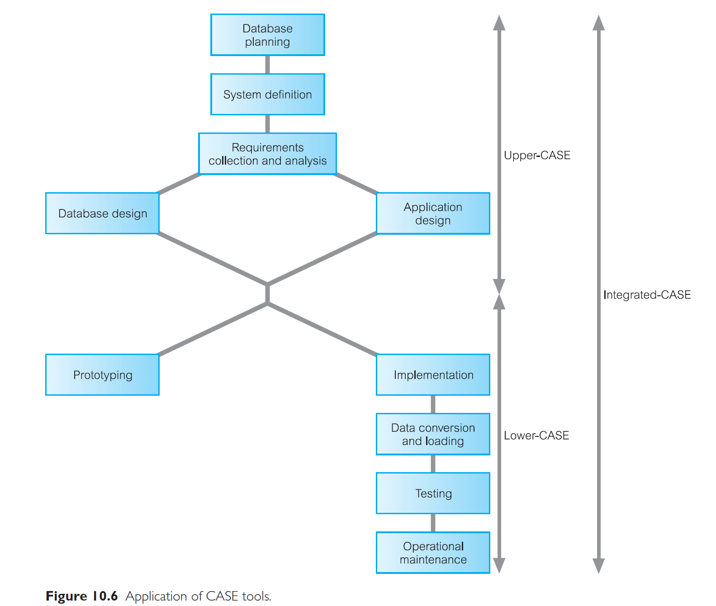

Slide 9
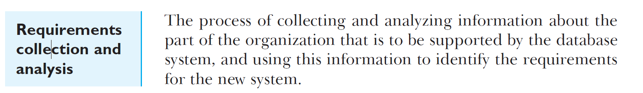

Slide 10
Analysis/Fact-finding techniques
It is critical to capture the necessary facts to build the required database application.
These facts are captured using fact-finding techniques.
The formal process of using techniques such as interviews and questionnaires to collect facts about systems, requirements, and preferences.
© Pearson Education Limited 1995, 2005

Slide 11
When Are Analysis/Fact-Finding Techniques Used?
Fact-finding used throughout the database application lifecycle. Crucial to the early stages including database planning, system definition, and requirements collection and analysis stages.
Enables developer to learn about the terminology, problems, opportunities, constraints, requirements, and priorities of the organization and the users of the system.
© Pearson Education Limited 1995, 2005

Slide 12
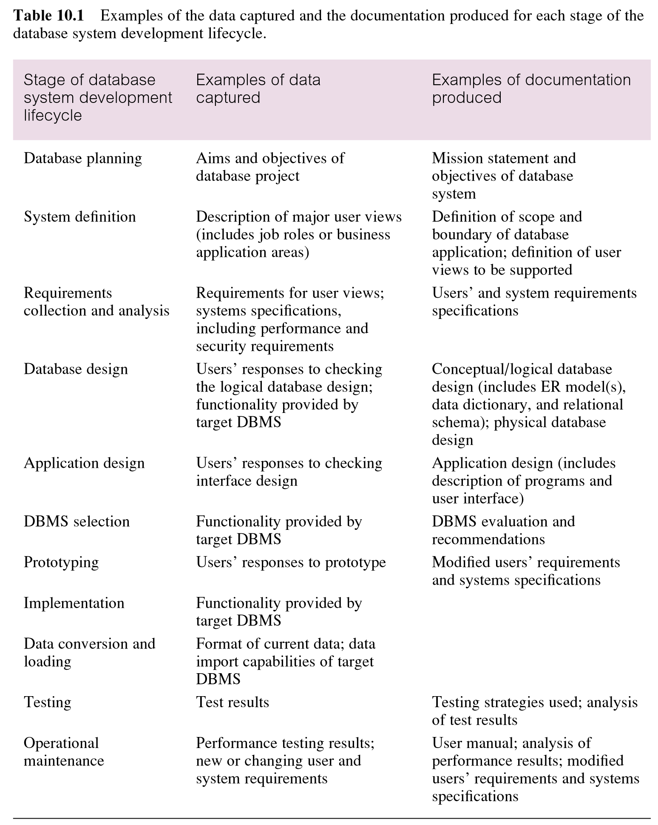
Examples of data captured and documentation produced during the database application lifecycle
© Pearson Education Limited 1995, 2005

Slide 13
Fact-Finding Techniques
A database developer normally uses several fact-finding techniques during a single database project including:
  examining documentation
  interviewing
  observing the organization in operation
  research
  questionnaires
© Pearson Education Limited 1995, 2005

Slide 14
Examining documentation
Can be useful
  to gain some insight as to how the need for a database arose.
  to identify the part of the organization associated with the problem.
  To understand the current system.
© Pearson Education Limited 1995, 2005

Slide 15
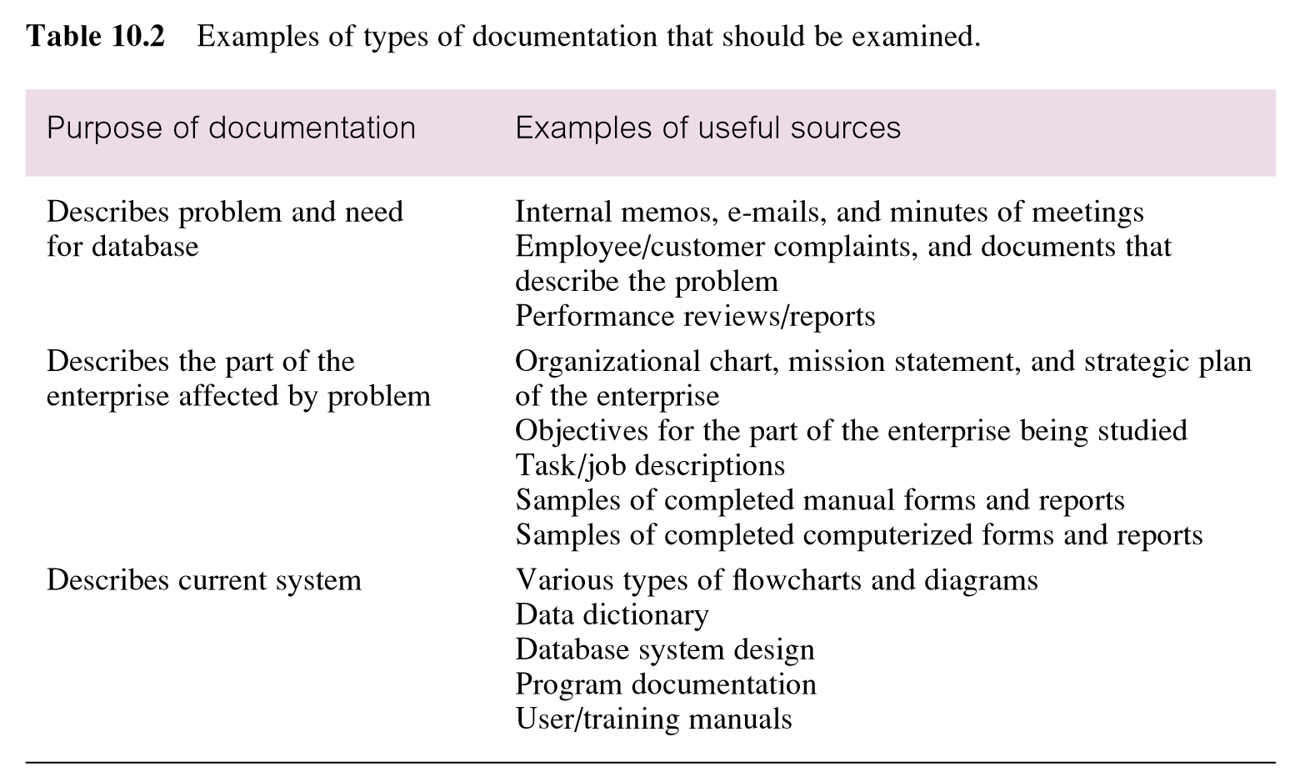
Examples of types of documentation that should be examined
© Pearson Education Limited 1995, 2005

Slide 16
Interviewing
Most commonly used, and normally most useful, fact-finding technique. Enables collection of information from individuals face-to-face.
Objectives include finding out facts, verifying facts, clarifying facts, generating enthusiasm, getting the end-user involved, identifying requirements, and gathering ideas and opinions.
© Pearson Education Limited 1995, 2005

Slide 17
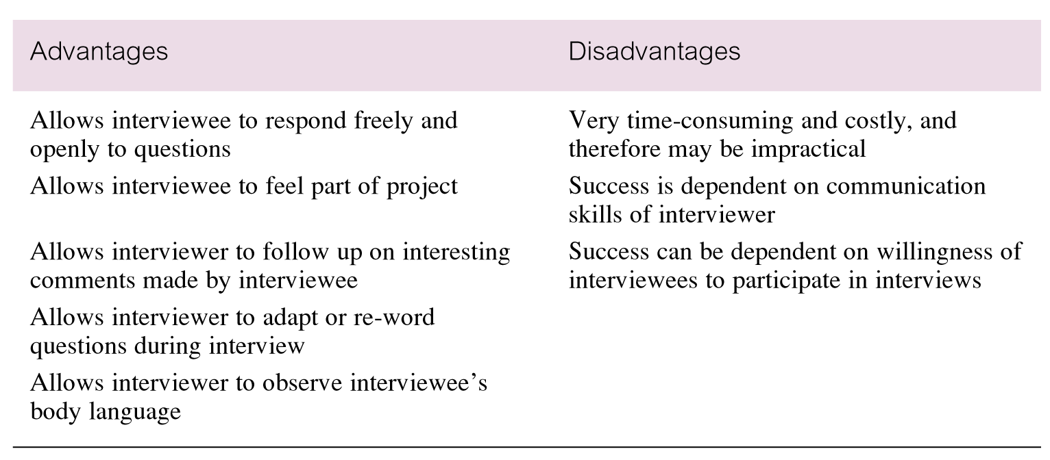
Advantages and disadvantages of interviewing
© Pearson Education Limited 1995, 2005

Slide 18
Interviewing
There are two types of interviews unstructured and structured.
Open-ended questions allow the interviewee to respond in any way that seems appropriate.
Closed-ended questions restrict answers to either specific choices or short, direct responses.
© Pearson Education Limited 1995, 2005

Slide 19
Observing the Organization in Operation
An effective technique for understanding a system.
Possible to either participate in, or watch, a person perform activities to learn about the system.
Useful when validity of data collected is in question or when the complexity of certain aspects of the system prevents a clear explanation by the end-users.
© Pearson Education Limited 1995, 2005

Slide 20
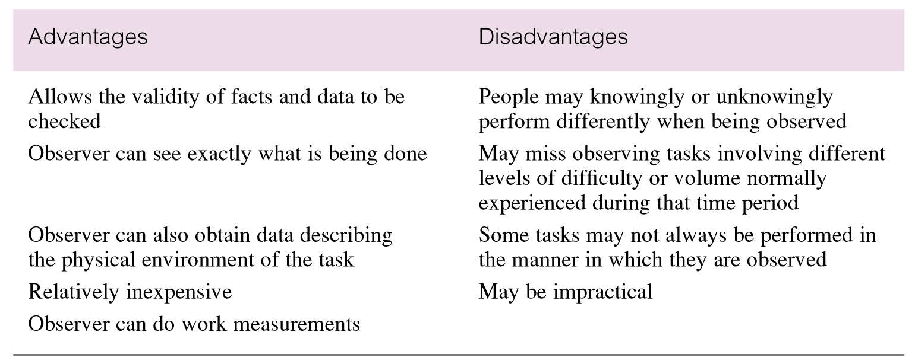
Advantages and disadvantages of using observation
© Pearson Education Limited 1995, 2005

Slide 21
Research
Useful to research the application and problem.
Use computer trade journals, reference books, and the Internet (including user groups and bulletin boards).
Provide information on how others have solved similar problems, plus whether or not software packages exist to solve or even partially solve the problem.
© Pearson Education Limited 1995, 2005

Slide 22
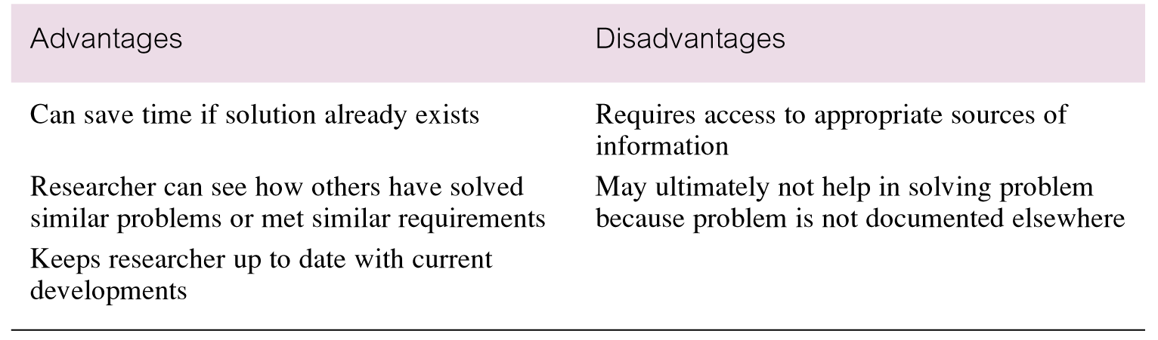
Advantages and disadvantages of using research
© Pearson Education Limited 1995, 2005

Slide 23
Questionnaires
Conduct surveys through questionnaires, which are special-purpose documents that allow facts to be gathered from a large number of people while maintaining some control over their responses.
There are two types of questions, namely free-format and fixed-format.
© Pearson Education Limited 1995, 2005

Slide 24
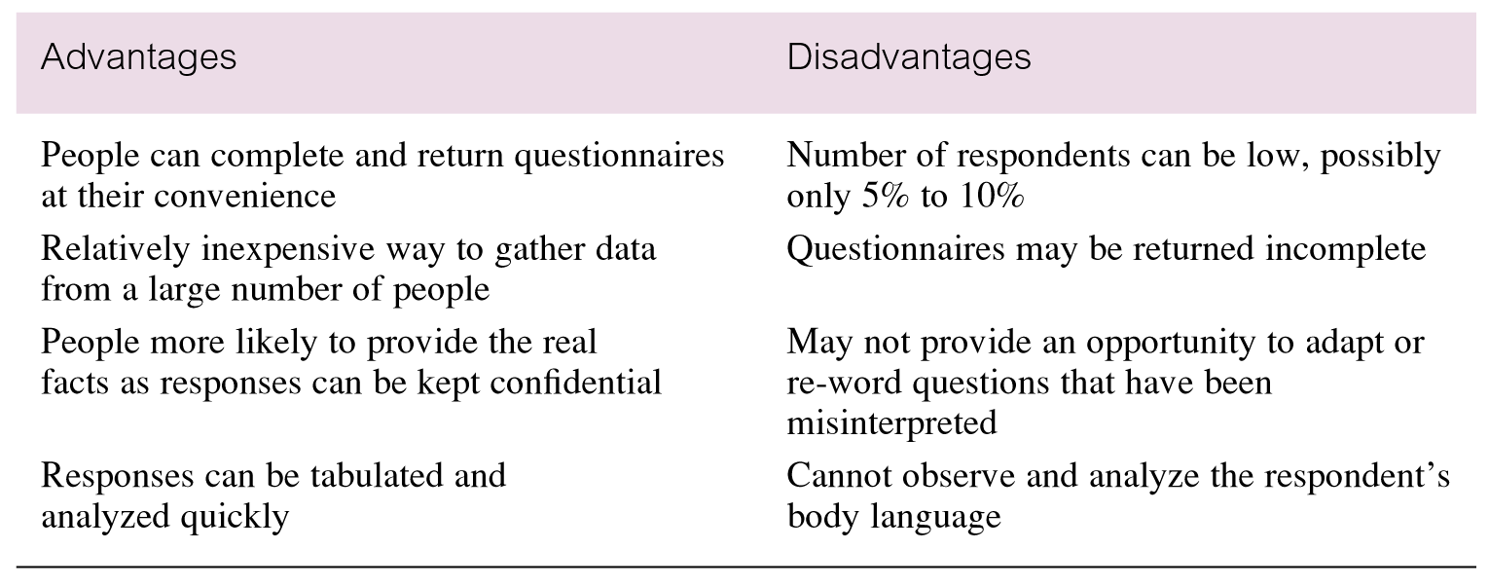
Advantages and disadvantages of using questionnaires
© Pearson Education Limited 1995, 2005

Slide 25
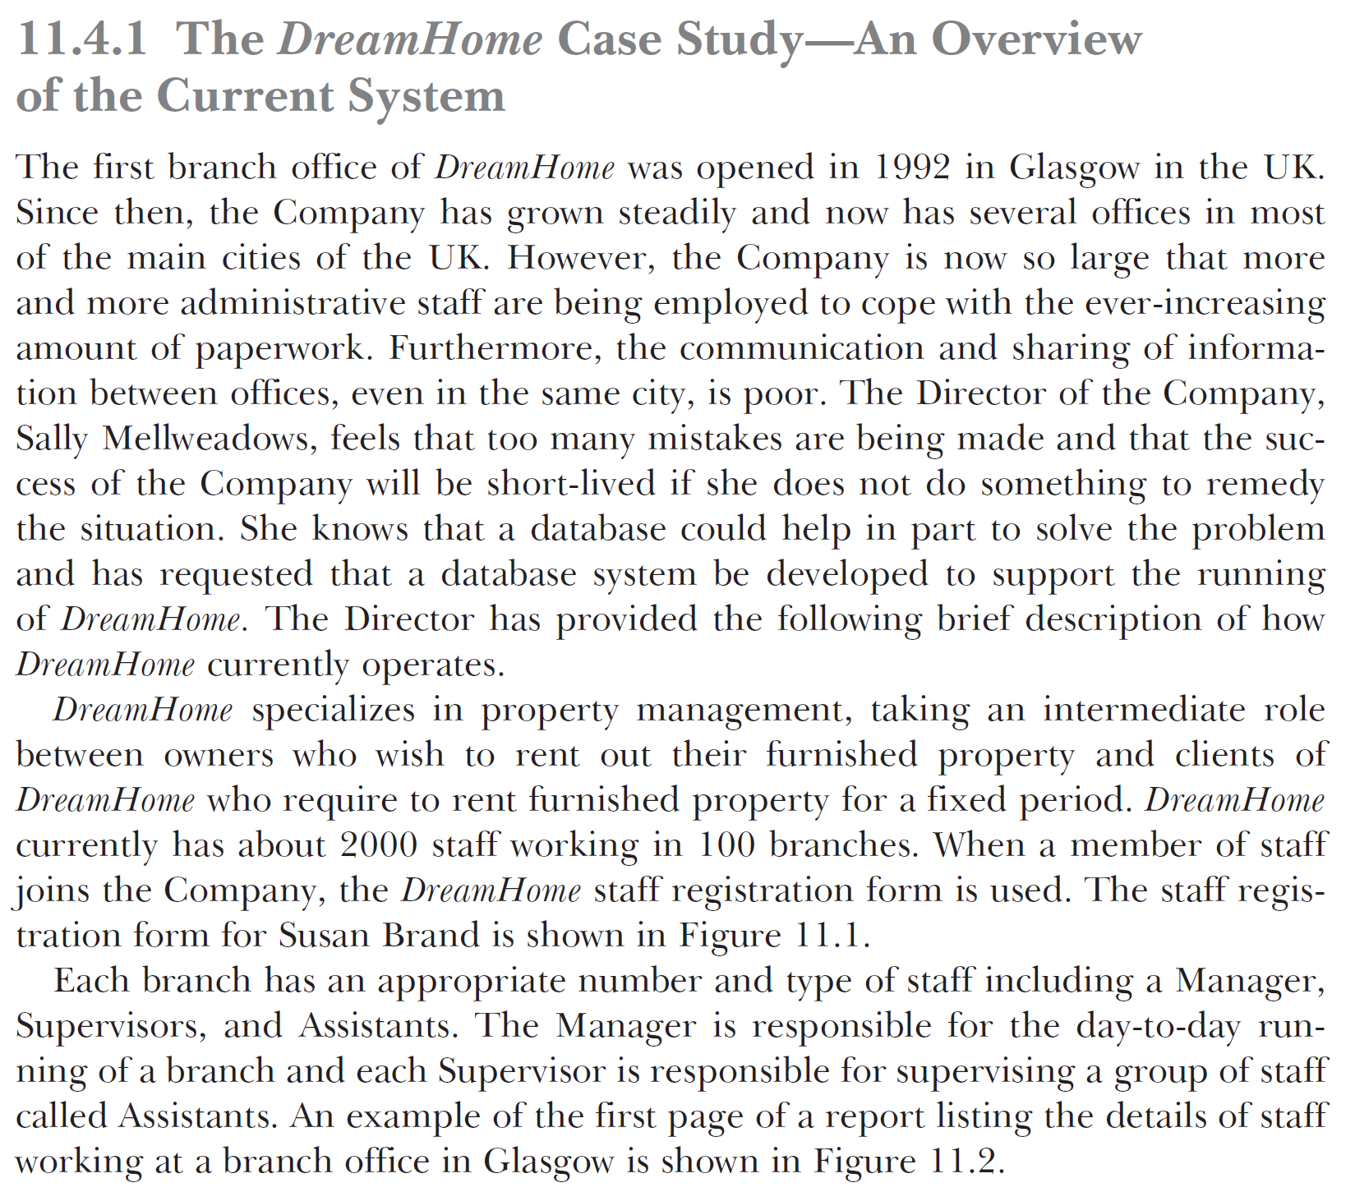

Slide 26
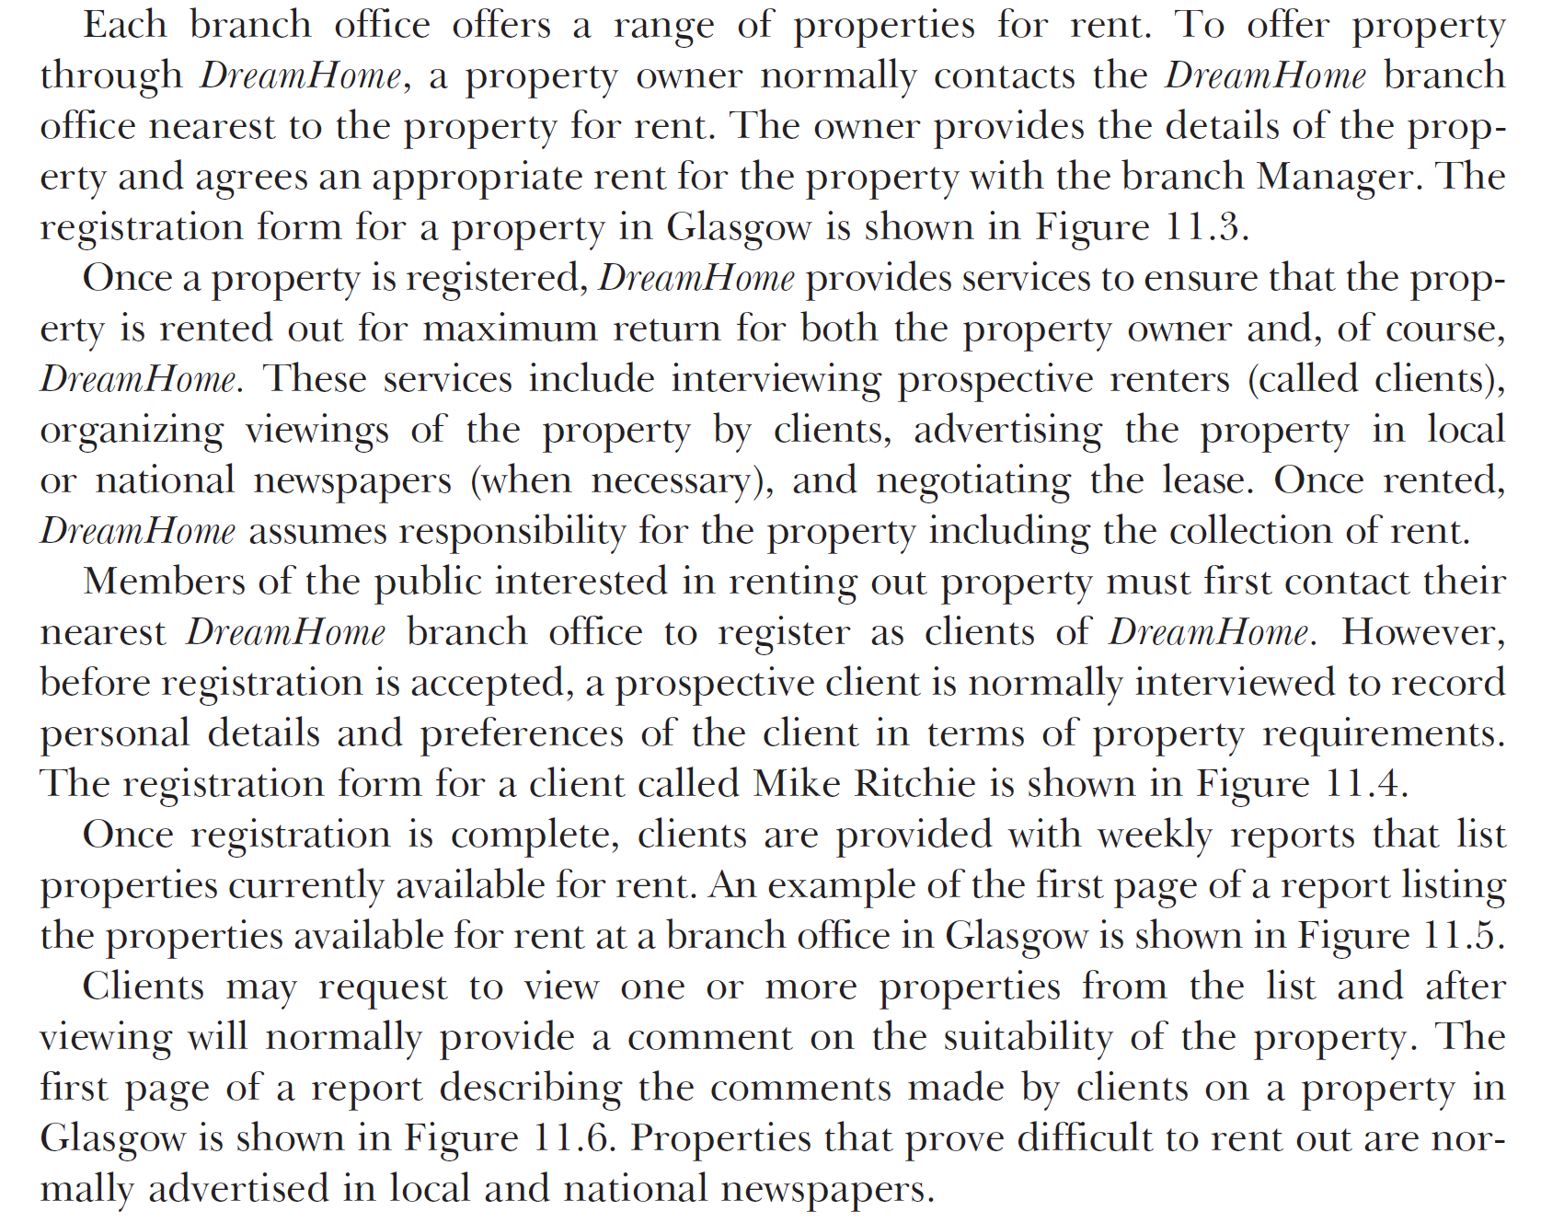

Slide 27
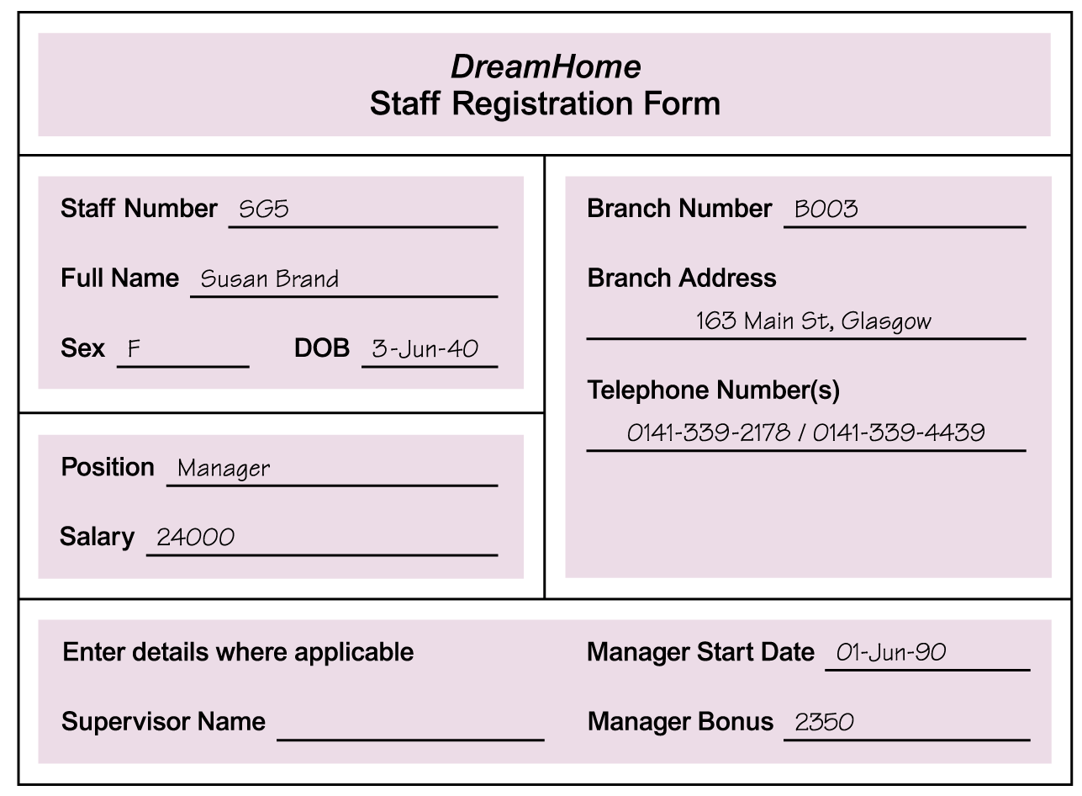
Using Fact-Finding Techniques –
A Worked Example
© Pearson Education Limited 1995, 2005

Slide 28
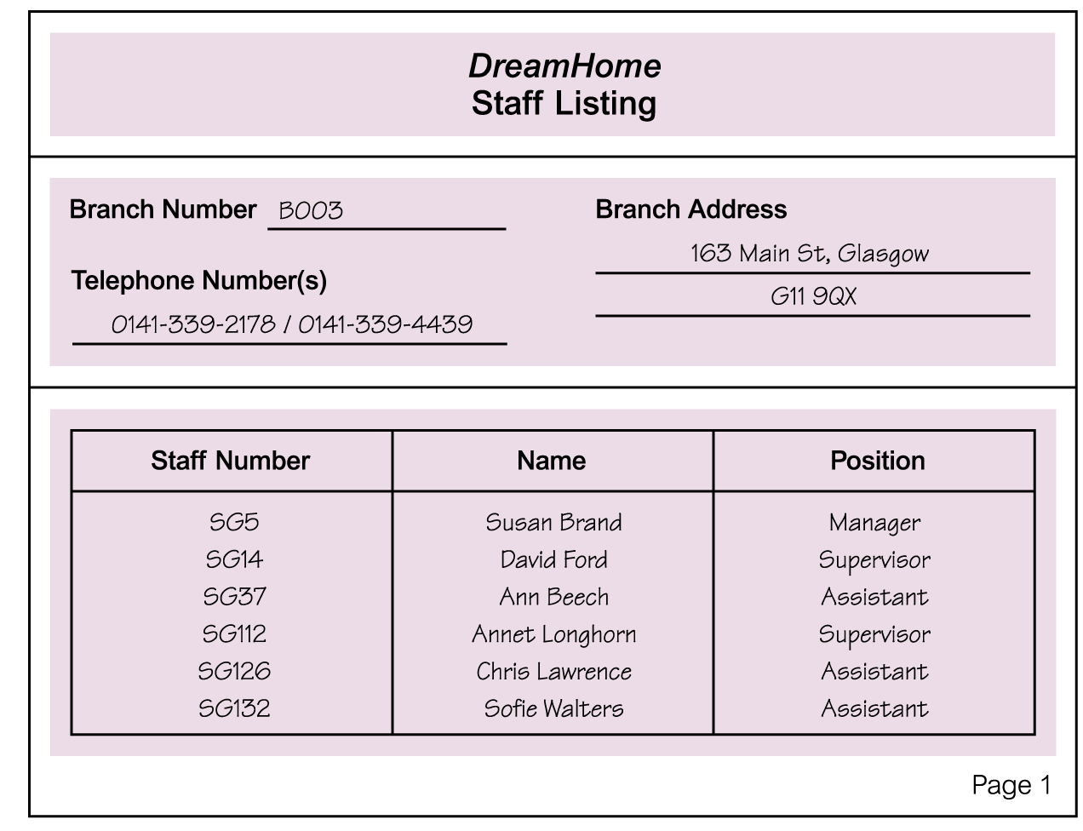
Using Fact-Finding Techniques –
A Worked Example
© Pearson Education Limited 1995, 2005

Slide 29
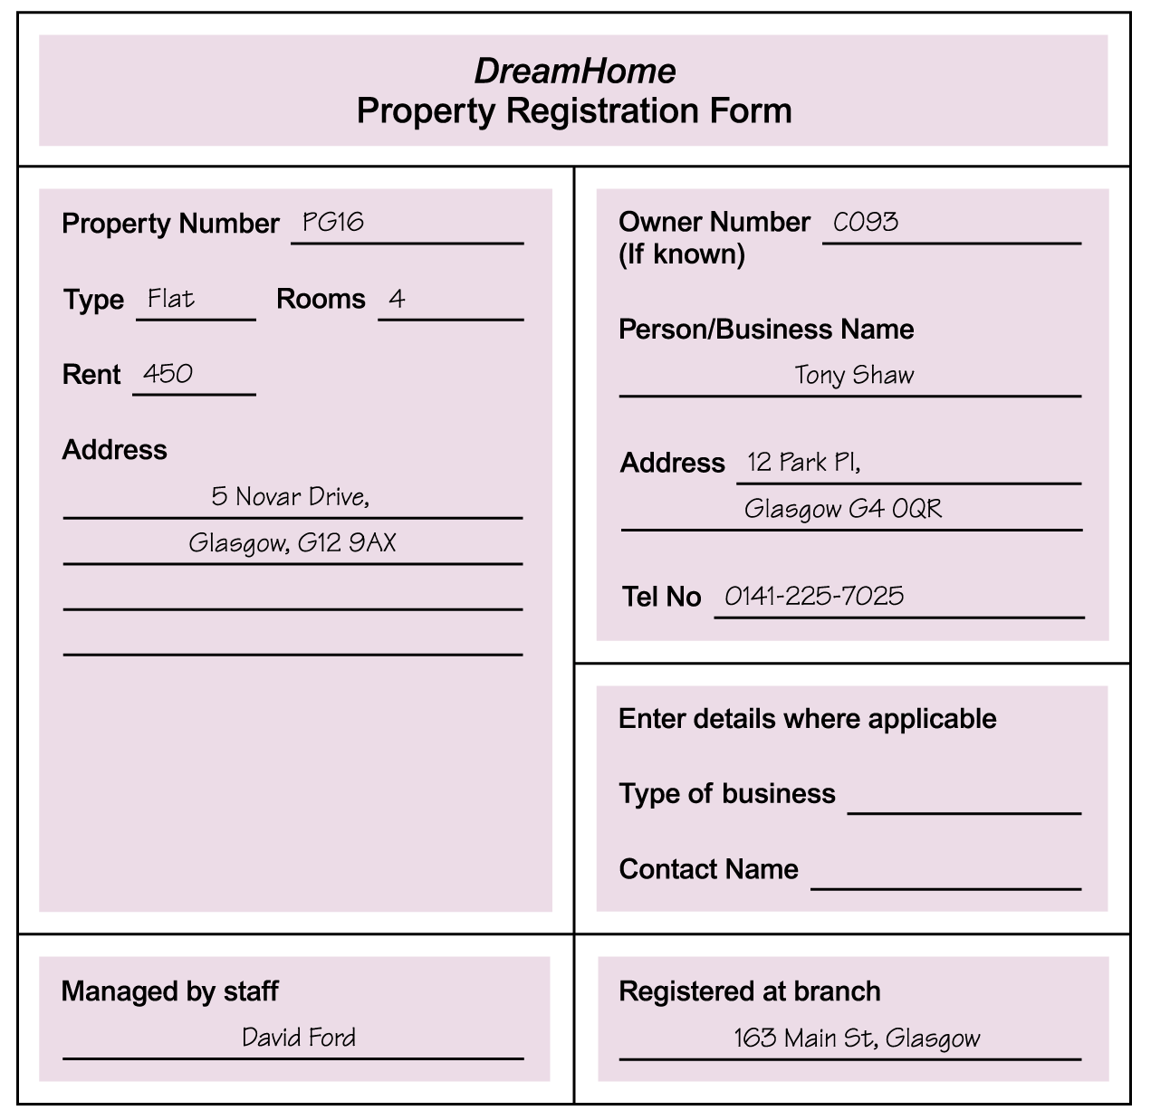
Using Fact-Finding Techniques –
A Worked Example
© Pearson Education Limited 1995, 2005

Slide 30
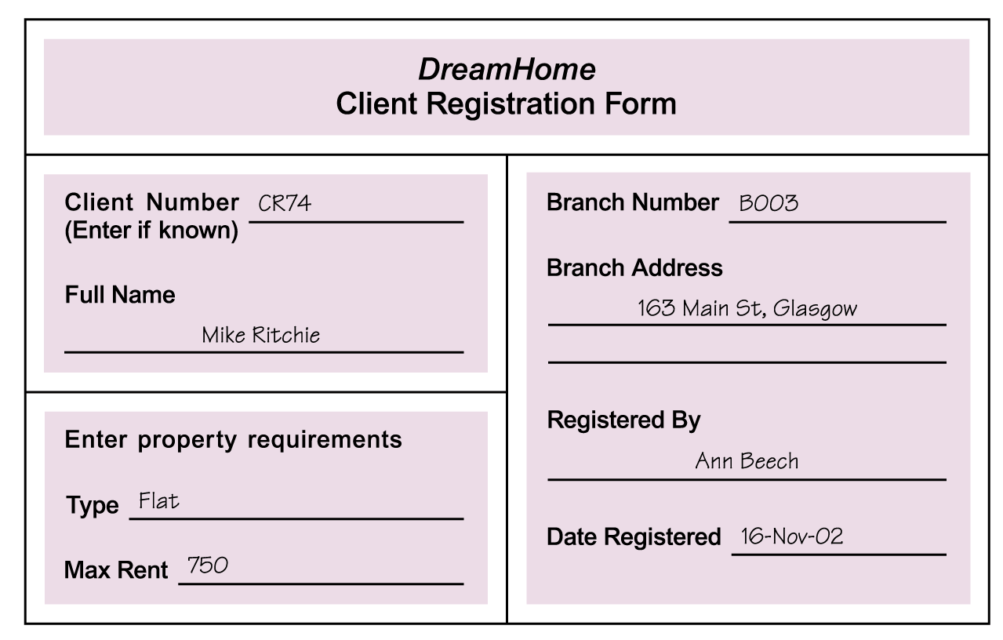
Using Fact-Finding Techniques –
A Worked Example
© Pearson Education Limited 1995, 2005

Slide 31
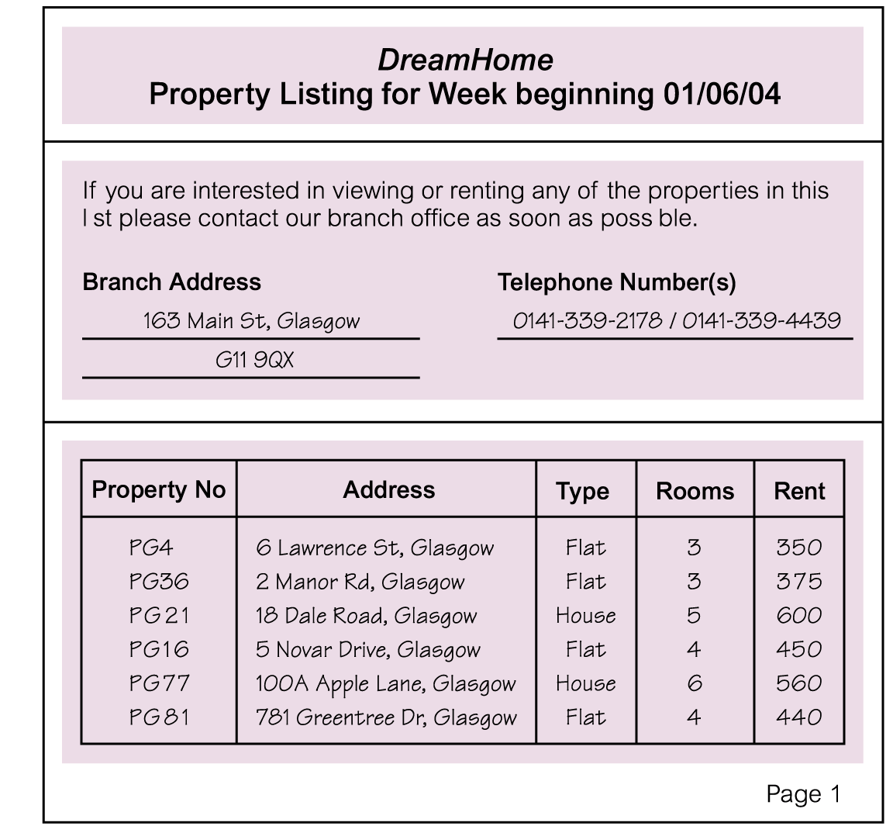
Using Fact-Finding Techniques –
A Worked Example
© Pearson Education Limited 1995, 2005

Slide 32
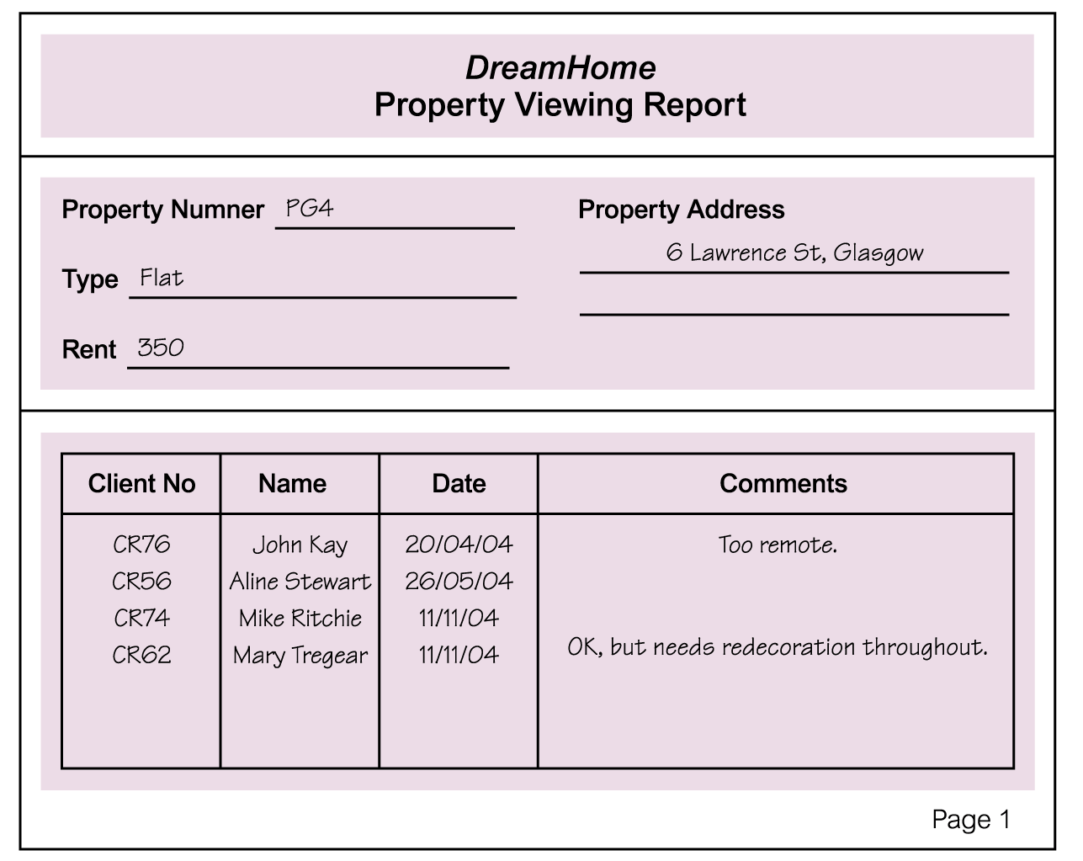
Using Fact-Finding Techniques –
A Worked Example
© Pearson Education Limited 1995, 2005

Slide 33
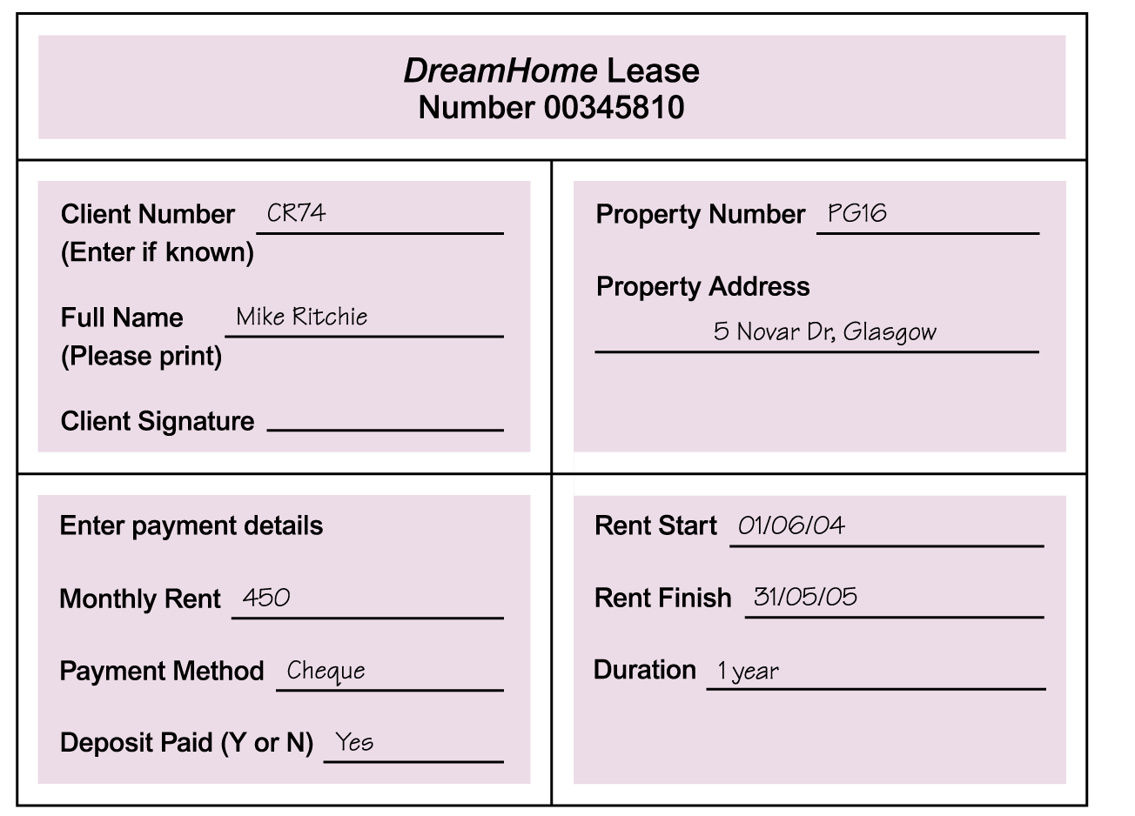
Using Fact-Finding Techniques –
A Worked Example
© Pearson Education Limited 1995, 2005

Slide 34
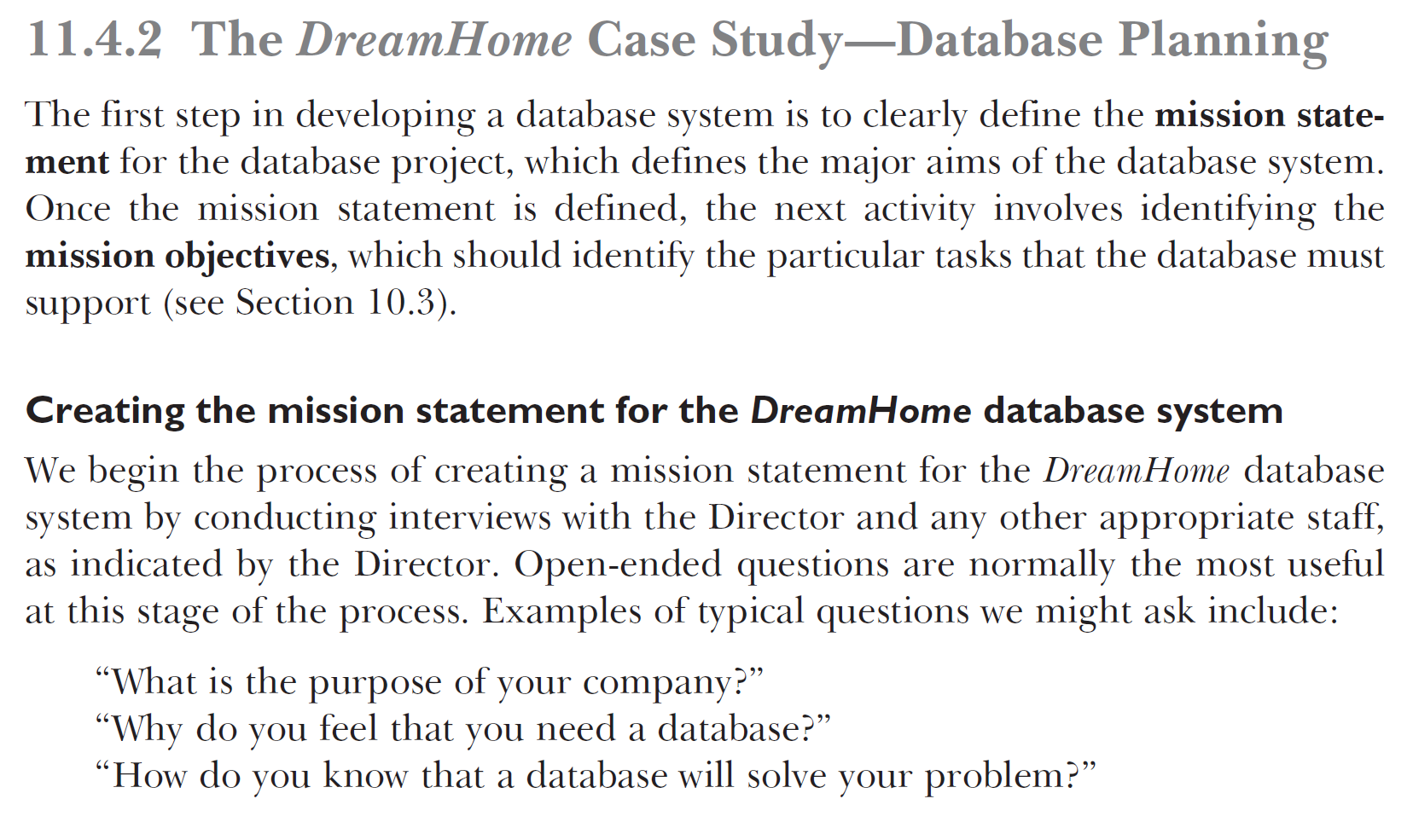
Book Page 386

Slide 35
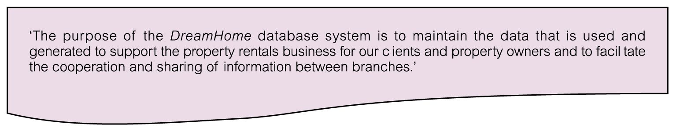
Mission Statement for DreamHome Database System
© Pearson Education Limited 1995, 2005

Slide 36
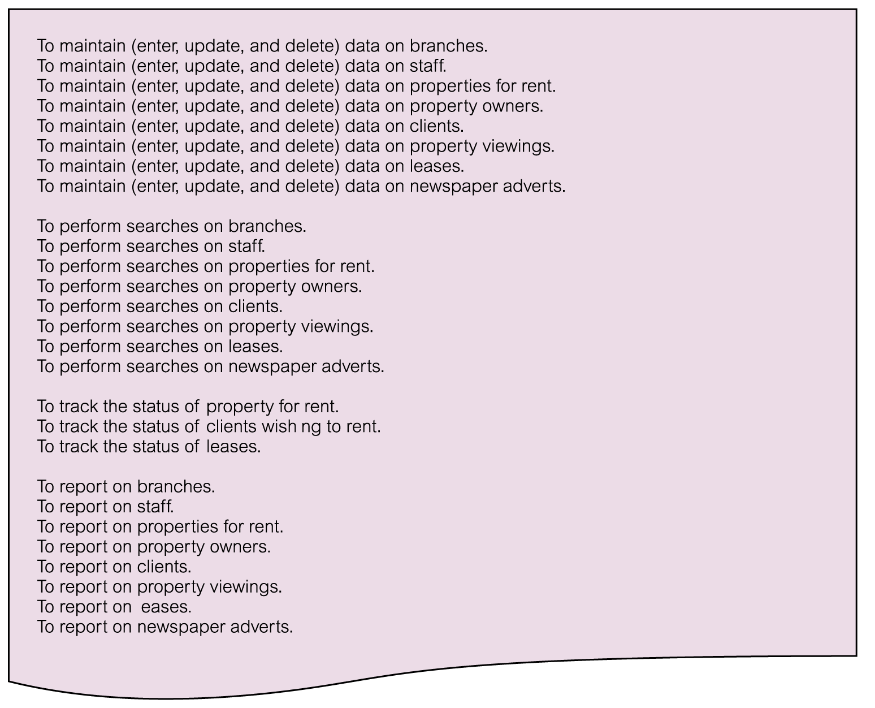
Mission Objectives for DreamHome Database System
© Pearson Education Limited 1995, 2005

Slide 37
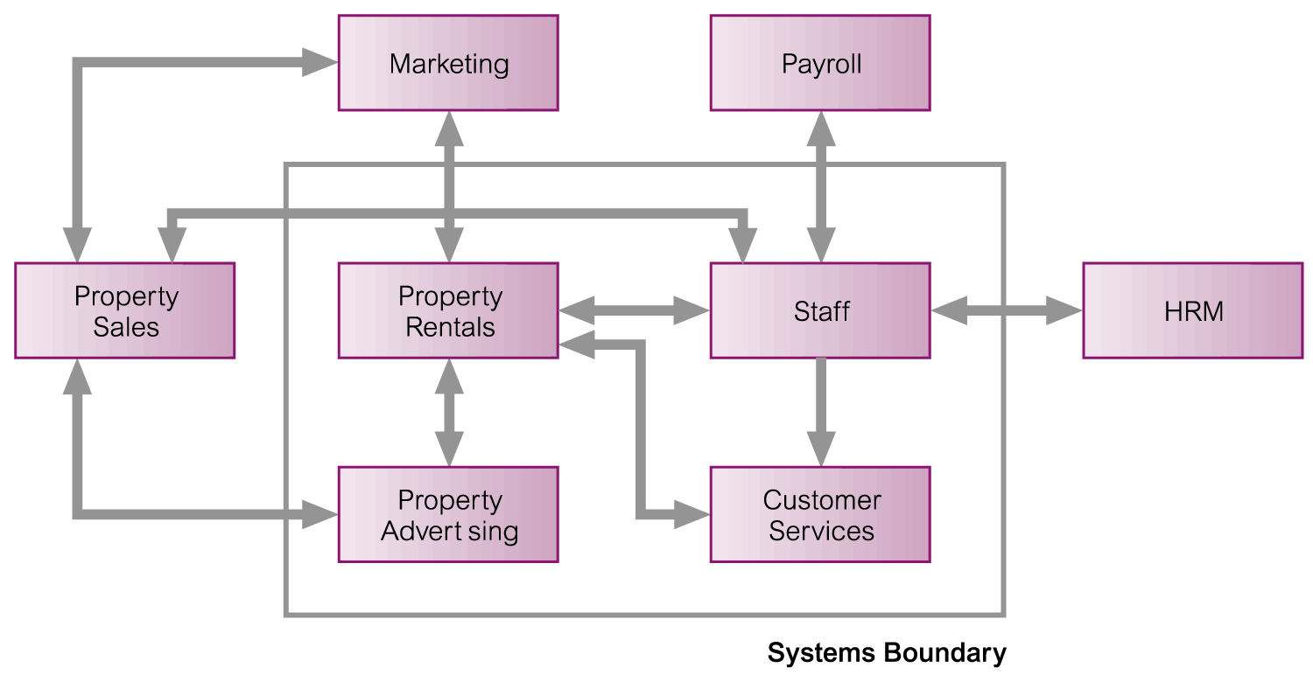
System Boundary for DreamHome Database System
© Pearson Education Limited 1995, 2005

Slide 38
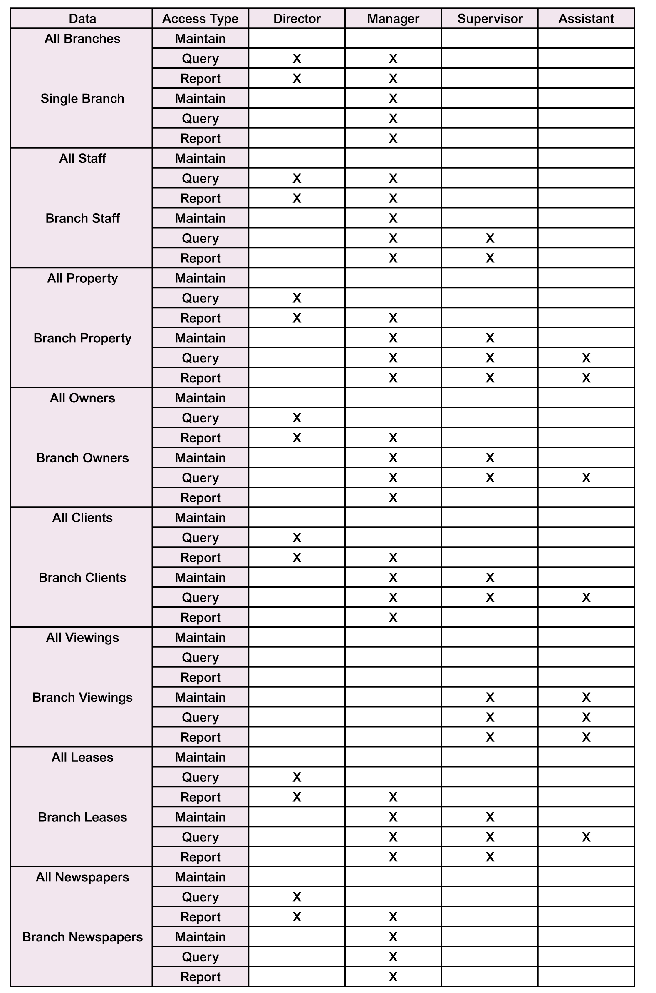
Major User Views for DreamHome Database System
© Pearson Education Limited 1995, 2005

Slide 39
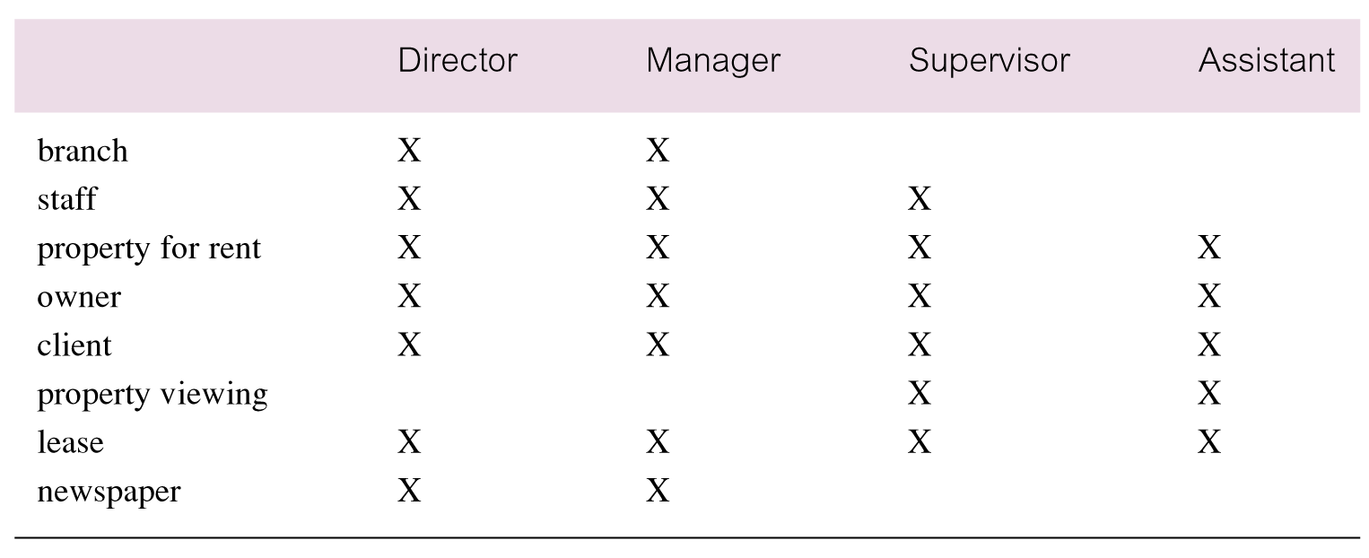
Cross-reference of user views with main types of data used by each
© Pearson Education Limited 1995, 2005

Slide 40
Today almost all basic transaction systems are automated.
Now it is more important, how to transform already implemented systems, using newer technologies; SW and HW!
Target : Repeated tasks are targeted to autonomous automation!

